Slide 1
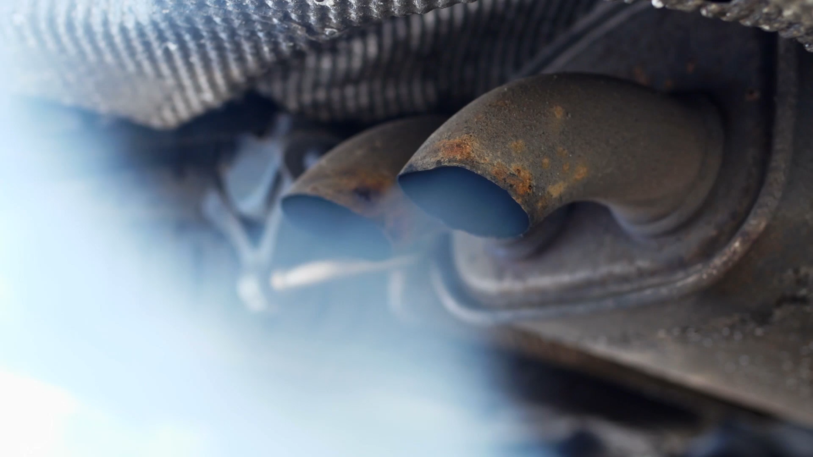
USED CARS DATASET
Sohini
Harshaanth
Joseph
Linda
Aldo

Slide 2

Motivation/ Business Context
The demand for used cars has been increasing drastically over the past few years, due to various factors such as, lower insurance premiums, less vehicle depreciation, lower customization costs, certifications and inspections, environmental sustainability, and lower annual registration fees.
However, a worldwide shortage of semiconductors and microchips have driven the used car prices higher for the past few years. Also, there are some limitations with used cars such as, accidental damages and number of owners, and the age of the car. Nevertheless, keeping the supply of cars low allows the dealers to charge more for used cars.
There are various things that need to be considered when it comes to buying used cars, such as, Mileage, Year, Mpg, Accident Damage, Manufacturer, Type of Ownership, Fuel Type, Type of Usage, etc.

Slide 3

Data Description
This dataset contains data about 762,091 used cars from cars.com. The data was collected in April 2023.
Source: Used Cars Dataset | Kaggle https://www.kaggle.com/datasets/andreinovikov/usedcars-dataset
File Type: csv file from Kaggle.com
Number of Records: There are a total of 762,092 individual records.
Significant Records: Manufacturer, Model, Year, Colors
Significant Quantitative Values: Price, Price Drop, Number of Accidents.

Slide 4
Data Description
Key Variables: There are 20 key variables/columns in the data
1. manufacturer - name of the car manufacturer
2. model - name of the car model
3. year - the year when the car was produced
4. mileage - the number of miles the car has traveled since production
5. engine - car engine
6. transmission - type of the car's transmission
7. drivetrain - type of the car's drivetrain
8. fuel_type - type of fuel that the car consumes
9. mpg - the number of miles a car can travel using one gallon of fuel (miles per gallon)
10. exterior_color - car exterior color
11. interior_color - car interior color
12. accidents_or_damage - whether the car was involved in accidents
13. one_owner - whether the car was owned by one person
14. personal_use_only - whether the car was used only for personal purposes
15. seller_name - name of the seller
16. seller_rating - seller's rating
17. driver_rating - car rating given by drivers
18. driver_reviews_num - the number of car reviews left by drivers
19. price_drop - price reduction from the initial price
20. price - car price

Slide 5
Data Preparation Required
Original Dataset:
762,092 records
Outliers in AVG Price with a standard deviation of > $4 million for Chevrolet and nearly $9 million for Dodge.
Approximately 23,000 records with null values for fuel type
Approximately 6,000 records for vehicles produced prior to the year 2000
Cleaned Dataset:
735,142 records
Removed outliers in Chevrolet and Dodge; resulting in standard deviations of $19,201 and $17,821 respectively
Removed records with null values for fuel type
Removed records for vehicles produced prior to the year 2000
Reasoning: The outliers in the average price made the data for those manufacturers nearly impossible to accurately evaluate for some of our research questions. Without removing them, the results of our analysis would have been heavily skewed. The records with null values also acted as outliers, requiring removal. Additionally, in order to compare relatively similar vehicles, any vehicle produced prior to 2000 needed to be removed. Without removal, newer vehicles would have been compared to "classic, or "vintage" vehicles, forcing skewed and false results.

Slide 6
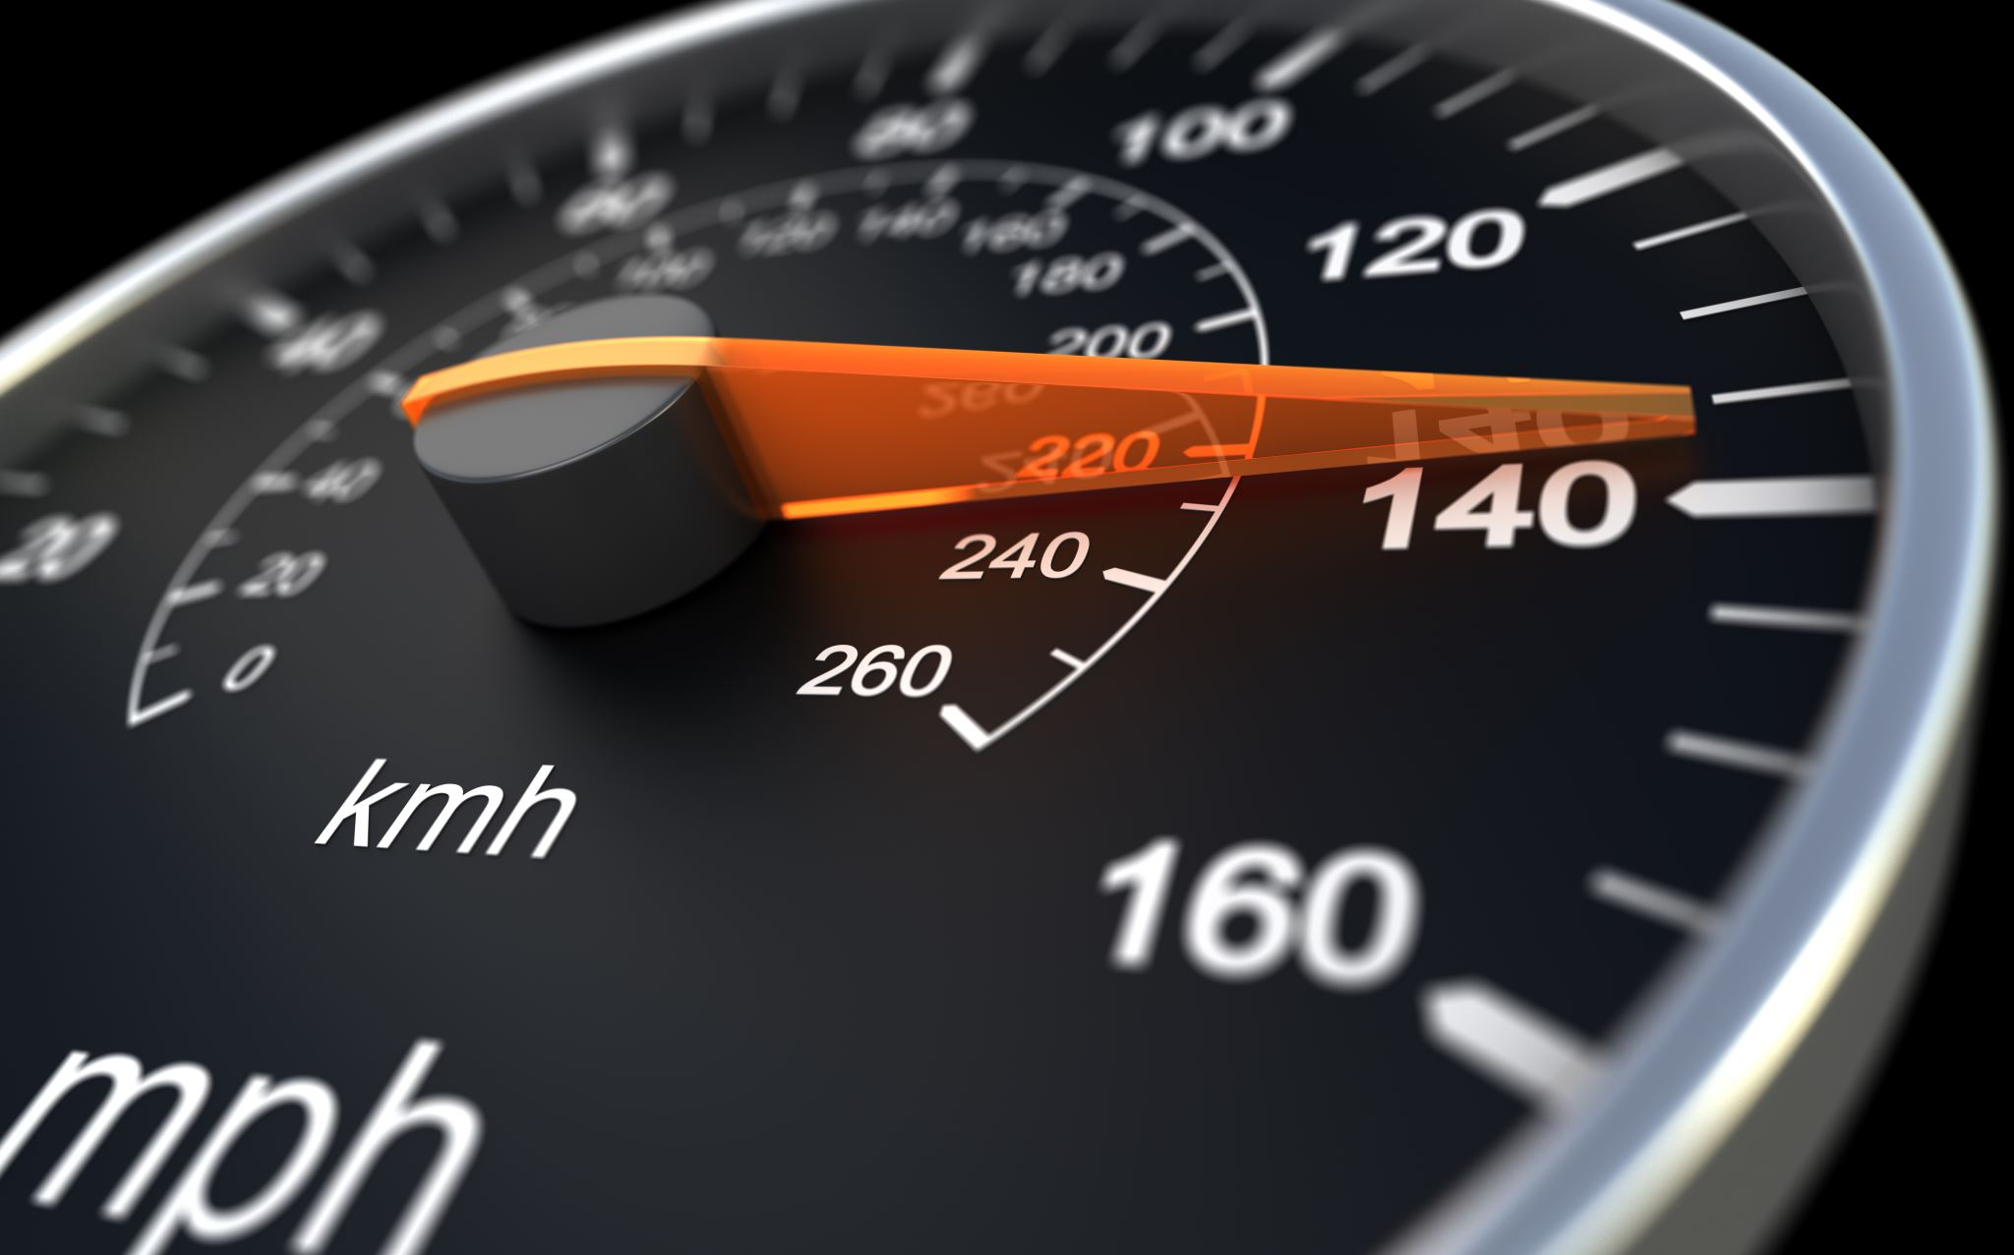
Research Questions
1. Which manufacturer has the highest average sales price?
2. Does the number of accidents that a vehicle has been in affect the sales price?
3. Which type of fuel offers better mileage? What is the mileage difference between cars manufactured before and after 2011?
4. How is the average price of cars used for personal use different from cars that are not used only for personal use?
5. Do the cars that were used only as personal vehicles have better mileage than others?
6. Which car model has the greatest price drop, and which one has the least? Does the car's color affect the price drop?

Slide 7

Methodologies
We used a wide array of charts to formulate answers to our research questions that include:
Bar Graphs
Box Graphs
Tree Maps
Line Graphs
Scatter Plots
Circle Views Plot

Slide 8
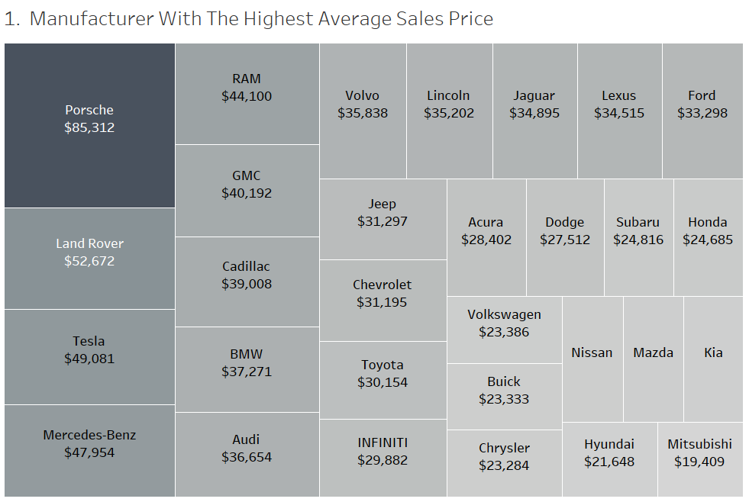
Joseph’s Methodologies
Which manufacturer has the highest average sales price?
Porsche has the highest average sales price, edging out the second highest, Land Rover, by a difference of over $30,000.
Dimension / Columns – Manufacturer
Value / Rows – Average Price

Slide 9
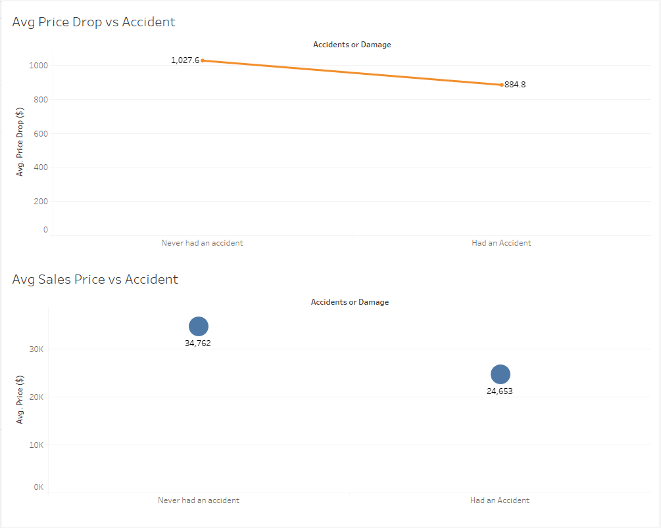
Sohini’s Methodologies
Does the number of accidents that a vehicle has been in affect the sales price?
If a car suffered from damage in one or more accidents, it would negatively affect its value, even if it has been fully repaired. The more damage it has, the lower the vehicle's value before the accident.
If a car has been in accident or if there is any damage, the average sales price will reduce by almost USD 10,109. It is a drop by almost 41% from the cars that never had an accident.
The amount that a car loses value after an accident constitutes a diminished value. This amount involves the difference between the car’s market value before the accident and the market value after an accident. The value decreases after the accident, which also reduces the average sales price of the car.
The average price drop difference between cars that had an accident and the cars that never had an accident was almost around $142.8 which is almost 16% lower than the ones that never had an accident.
Dimension / Columns – Accidents or Damage
Value / Rows – Average Price Drop and Average Price

Slide 10
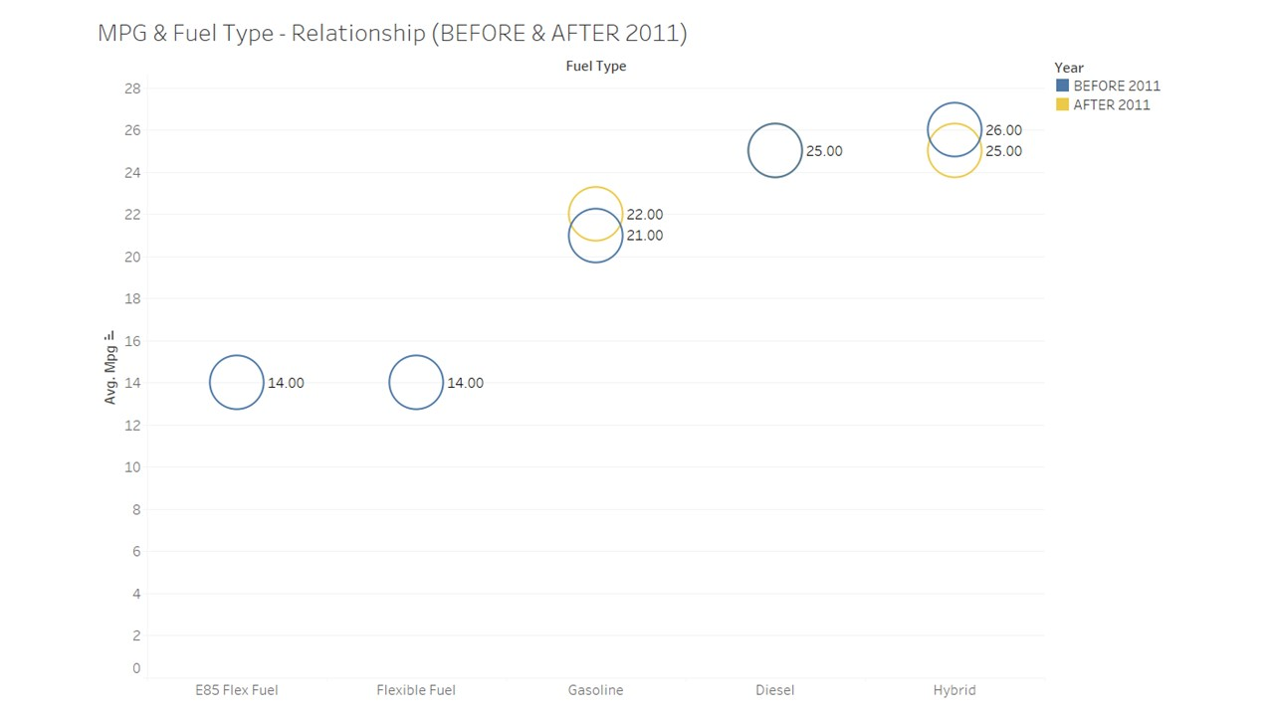
Harsha’s Methodologies
Which type of fuel offers better mileage? What is the mileage difference between cars manufactured before and after 2011?
Used cars with Hybrid fuel provide a maximum average mileage of 26 MPG in comparison to the previous decade, which is lowered to 25 MPG in the present decade and is equaled by Used cars with Diesel fuel, which likewise delivers an AVG mileage of 25 MPG constantly over the past two decades.
There is also a significant rise in average mileage from 21 MPG to 22 MPG for used cars that run on gasoline. Furthermore, used cars with E85 flex fuel and flexible fuel that averaged 14 MPG last decade have not been found in the present decade.
Hybrid cars use two power sources. By sharing the load with an electric motor, the engine in a hybrid car uses less fuel to run than a traditional car. This means a full tank will go further, lowering your running costs. The key reasons to consider buying a hybrid car are to save on gas and help reduce emissions while still getting the range capabilities of a gas car.
Dimension / Columns – Fuel Type
Value / Rows – AVG (MPG)
Marks / Filters / Colors – Years (Before and after 2011)
This graph compares the miles per gallon gained by used cars that use different fuels, as well as how these MPG disparities have changed over the last two decades.

Slide 11
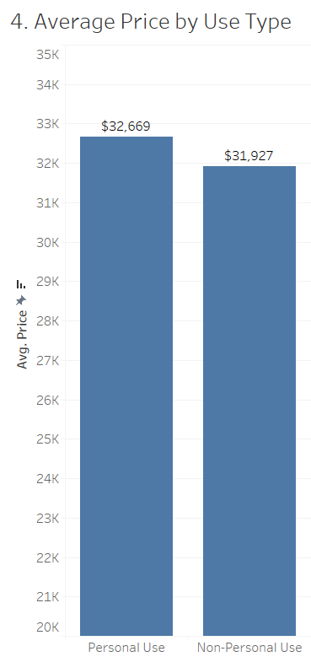
Joseph’s Methodologies
How is the average price of cars used for personal use different from cars that are not used only for personal use?
Vehicles used strictly for personal use are valued only slightly higher than non-personal use vehicles. The difference between the two categories was only an average of $742, which is only 2% of the average sales price.
Dimension / Columns – Personal Use Only
Value / Rows – Average Price

Slide 12
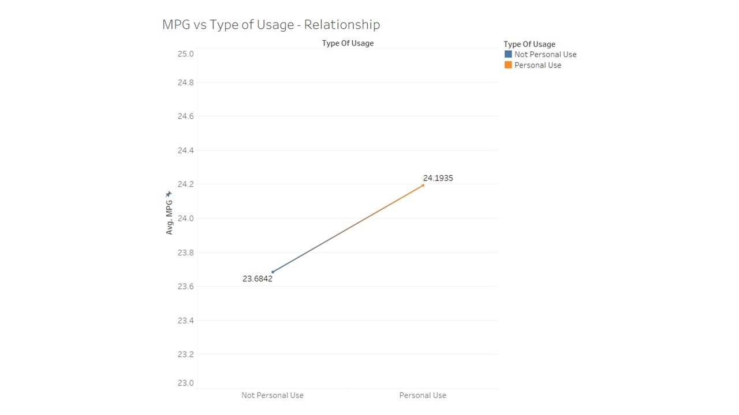
Aldo’s Methodologies
Which type of vehicles have higher mileage per gallon?
The graph explains about the Avg MPG VS personal/private(not personal use) cars.
In the graph there is an evident difference between the avg mileage in personal and non-personal vehicles due to the following factors:
Majorly in not personal vehicles the drivers tend to drive rash due to excessively being on the road. The vehicle is driven for longer durations which lead to wear and tear of parts which are caused due to fatigue and heat caused from continuously moving of automotive parts.
Poor maintenance of not personal used cars lead to further degradation of the parts thereby reducing the mileage drastically.
The distance travelled by not personal cars are pretty much higher when compared to personal use vehicles.
Dimension / Columns – Personal / Not personal use
Value / Rows – Average MPG.

Slide 13
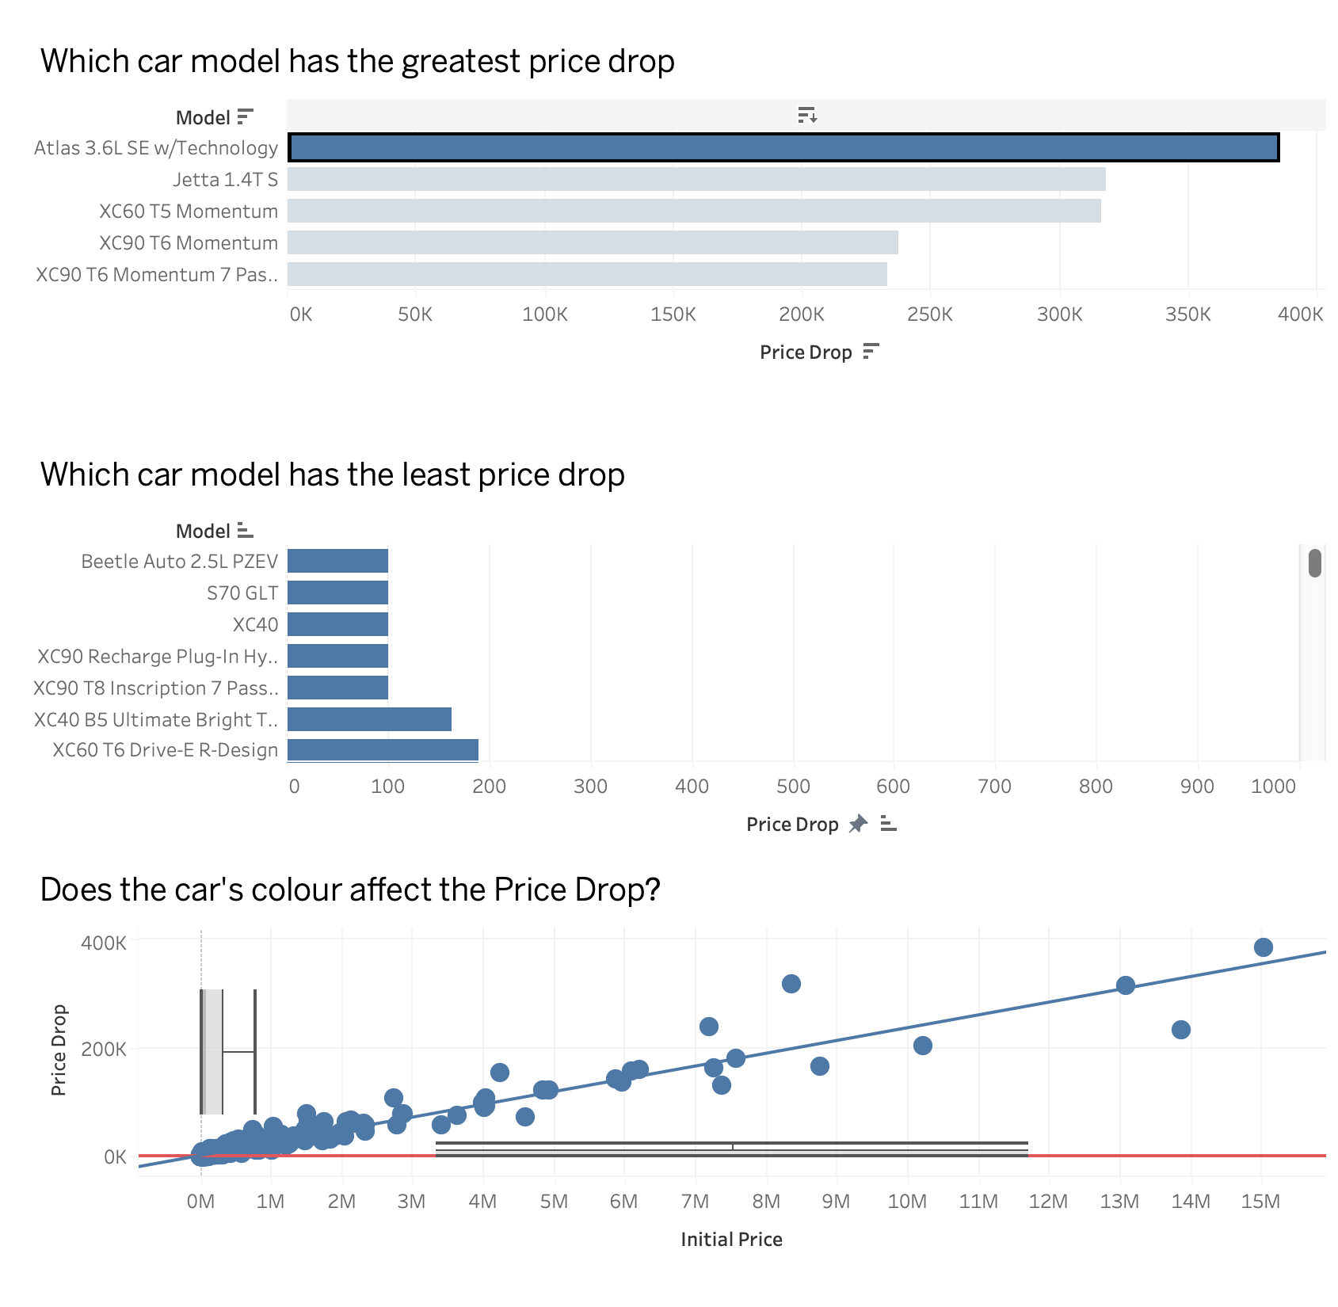
Linda’s Methodologies
Which car model has the greatest price drop, and which one has the least? Does the car's color affect the price drop?
The car model with the greatest price drop is the "Volkswagen Atlas 3.6L SE w/Technology," while there are five car models with the least price drop, all of which only decreased by $100, including "Volvo XC40," "Volvo XC90," "Volkswagen Beetle Auto 2.5L PZEV," etc.
Regarding the analysis of the impact of car color on price drop, we added the Initial price as an indicator. From the visualization, it is evident that car color has an influence on the price drop, showing a positive correlation.
Dimension / Columns – Model, Exterior Color
Value / Rows – Price Drop, Initial Price

Slide 14
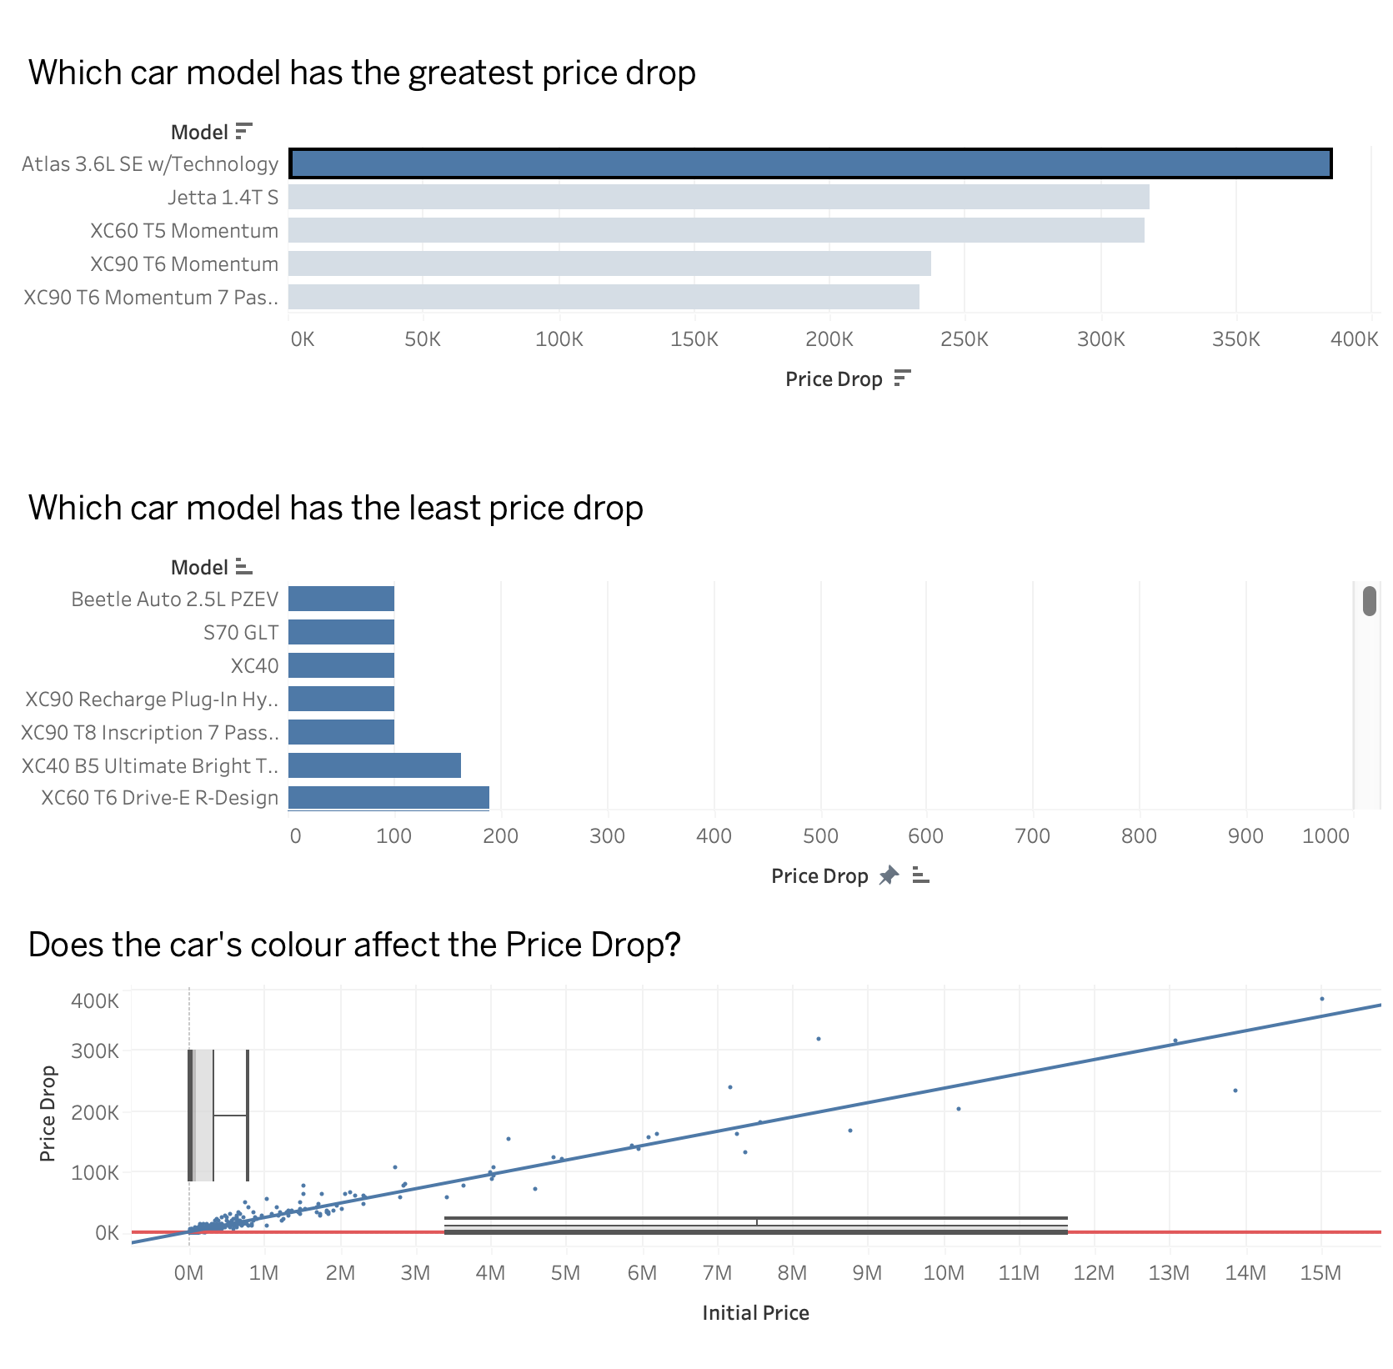
Dashboard

Slide 15
Dashboard

Slide 16

Results
Porsche has the highest average sales price, edging out the second highest, Land Rover, by a difference of over $30,000.
The average sales price will drop by around USD $10,109 if a car has been in an accident or has any damage. From the cars that never had an accident, there has been a decrease of almost 41% in the sales price. The average price difference between vehicles involved in accidents and vehicles not involved in accidents was over $142.8, or nearly 16% less than the vehicles not involved in accidents.
Used cars with Hybrid fuel type offer a maximum average mileage of 26 MPG.
The average MPG of personal cars are 24.1925 and the average MPG of not personal cars are 23.6842.
Vehicles used for personal use only had an average sales price of $742, or 2% of the average sales price, higher than those used for non-personal use.
The findings emphasize the importance of considering the specific car model's depreciation rate when making a purchasing decision. Understanding which models retain their value better can help consumers make informed choices and potentially save money in the long run.
The positive correlation between car color and price drop indicates that certain colors may be more desirable in the used car market, leading to higher resale values. Car owners and manufacturers can leverage this information to cater to consumer preferences and potentially enhance the appeal of their vehicles.

Slide 17
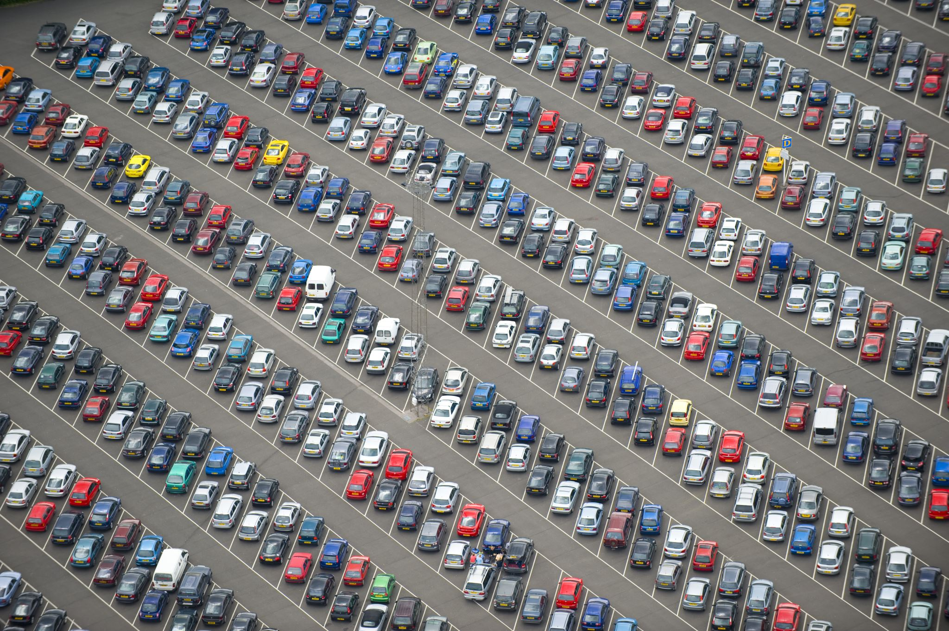
Lessons Learned
A thorough interrogation of the data you with to use is absolutely mandatory prior to any level of analysis. Without cleaning our data, we would have been drawing conclusions based on misleading information. For example, the sales price of a 2009 Chevrolet Cobalt with 85,000 miles being sold for $1 billion, as our original data indicated.
Hybrid cars use two power sources. By sharing the load with an electric motor, the engine in a hybrid car uses less fuel to run than a traditional car. This means a full tank will go further, lowering your running costs. The key reasons to consider buying a hybrid car are to save on gas and help reduce emissions while still getting the range capabilities of a gas car.
Even if a car has been completely repaired, it would lose its value if it had been involved in one or more accidents and if it suffered from any damage. The car’s average sales price prior to the accident and its value following the accident differs by almost 40%. After the accident, the value drops, lowering the car's average selling price. The amount that a car loses value after an accident constitutes a diminished value that involves the difference between the car’s market value before the accident and the market value after an accident.
Finding and creating appropriate metrics during the analysis process is crucial.
Majorly in not personal vehicles the drivers tend to drive rash due to excessively being on the road. The vehicle is driven for longer durations which lead to wear and tear of parts which are caused due to fatigue and heat caused from continuously moving of automotive parts.

Slide 18

Thank you! Q & A

Slide 19
Reference
Used Cars Dataset / Kaggle
https://www.kaggle.com/datasets/andreinovikov/usedcars-datasetataset

